Slide 1
Restructuring Roundtable June 16, 2017
Erich Stephens CEO

Slide 2
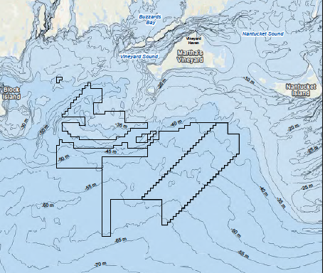
Project Area

Slide 3
50 / 50 partnership of two leading renewable energy companies
Long-term, clean energy infrastructure focus
Invests on behalf of 21 institutional investors
Some of largest Scandinavian pension funds
Early engagement / buy and hold
Today manages over € 5 billion
One of US’s largest wind owner / operators
6 GW of wind in 22 states
Part of Iberdrola group:
World largest renewables asset base
14,000 megawatts renewable energy
12 countries

Slide 4
Offshore wind strength from both investors
COP
Copenhagen Offshore Partners
Specialized team to deliver CIP’s offshore wind
Individuals on team have had key roles on :
More than 15 offshore wind projects in Europe
10 of the 15 largest projects to date
As early as world´s 2nd offshore wind farm, built in 1995
Veja Mate, 402 MW, Germany
Beatrice, 588 MW, UK
West of Duddon Sands: UK, 389 MW, 2014 COD
Wikinger: Germany, 350 MW, 2017 COD
East Anglia One: UK, 714 MW, 2020 COD
St. Brieuc: France, 496 MW

Slide 5
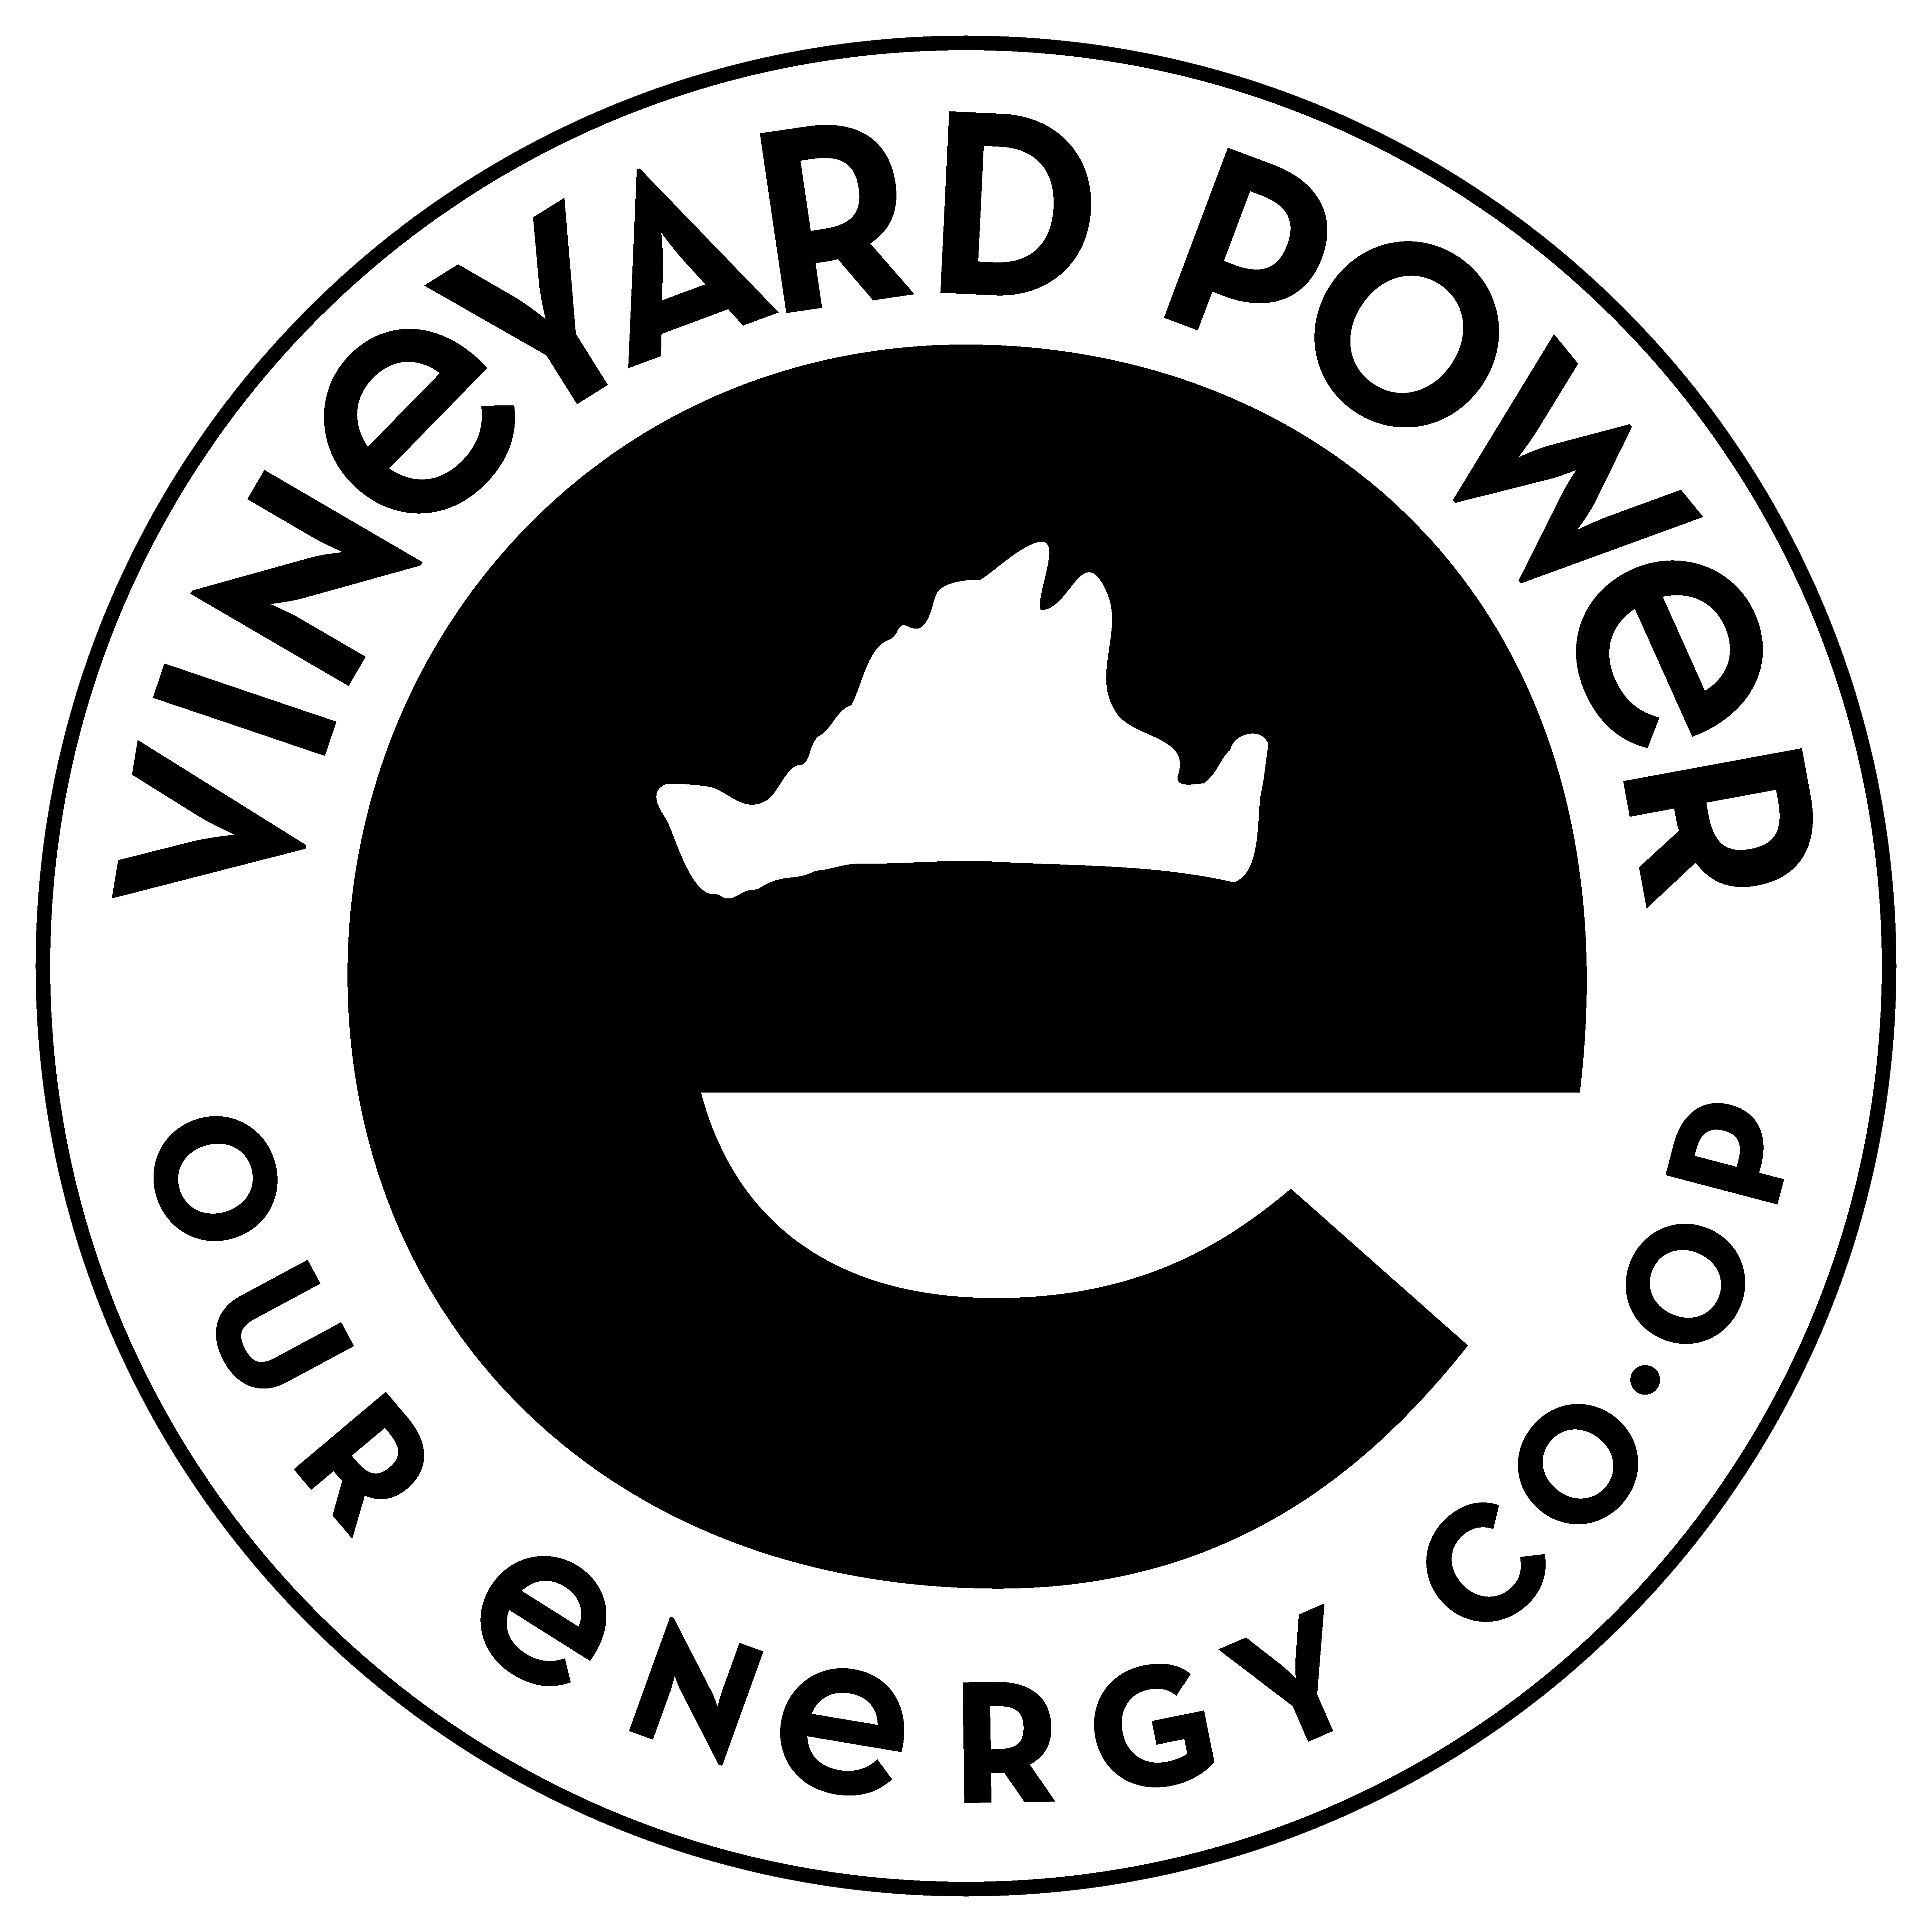
Managed as a project-focused, local company
Based in New Bedford
Local staff
Permitting
Grid connection
O&M
Community Partnership with Vineyard Power Coop
10% of island’s utility meters

Slide 6
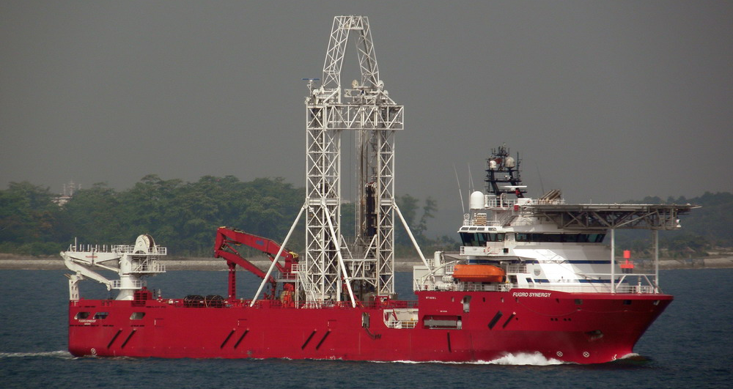
Ready to bid: 2017 Ready to build: Early 2020’s
Development of site well underway
First geological survey completed 2016
Second geological survey starting July 2017
Permit applications well progressed
Grid connection application submitted to ISO-NE
New Bedford Terminal Letter of Intent

Slide 7
Connecting New England offshore wind: The Issues
Lowest cost for ratepayers
Minimize environmental impacts
Maintain or enhance system reliability
Minimize impacts for other offshore users
Stay within existing federal [and state] law
Support sustainable build-out of offshore wind
Allow projects underway to proceed on schedule
Schedule misalignment
Project-on-project risks

Slide 8
Each issue is complicated
E.g. “Minimize environmental impacts”
Fewest number of cables?
Fewest cable miles?
Offshore vs. near-shore?
Along coast vs. perpendicular to coast?
Size of cable relevant?
Cable landings? (number and where and how)
Upland issues?

Slide 9
Each issue relates to the other issues
Lowest cost for ratepayers
Minimize environmental impacts
Maintain or enhance system reliability
Minimize impacts for other offshore users
Stay within existing federal [and state] law
Support sustainable build-out of offshore wind
Allow projects underway to proceed on schedule
Lowest cost for ratepayers
Minimize environmental impacts
Maintain or enhance system reliability
Minimize impacts for other offshore users
Stay within existing federal [and state] law
Support sustainable build-out of offshore wind
Allow projects underway to proceed on schedule
?

Slide 10
Lessons learned from Europe
Construction project-on-project risk very real
Germany: € 100’s of millions in stranded costs paid by ratepayers due to delay
UK: Every OSW project has opted to build its own connection
Operational project-on-project risk very real
UK: Misalignment of cable operator’s and generator’s risks and costs
Competition is good at reducing costs (UK, Denmark, Germany, Netherlands)
But good policy is key to delivering savings to ratepayers
E.g. UK “OFTO” policy: savings of lower capital for connection may not be reflected in price
Local utilities not necessarily any better suited to provide connection
Germany: Delays
UK: Not competitive

Slide 11
Technology is improving
Lighter weight, more compact offshore transformer platforms
Lift transformer platform using same vessel as used for turbine
Considerable cost savings and risk reduction (esp. in US given Jones Act)
Reliability achieved through multiple platforms
AC technology
Cable/voltage optimization
Dynamic capacity ratings
At same time, HVDC technology still limited to specialized applications
Very long distances
Need to transmit large amounts of MW with limited cables (or if sync issues)

Slide 12
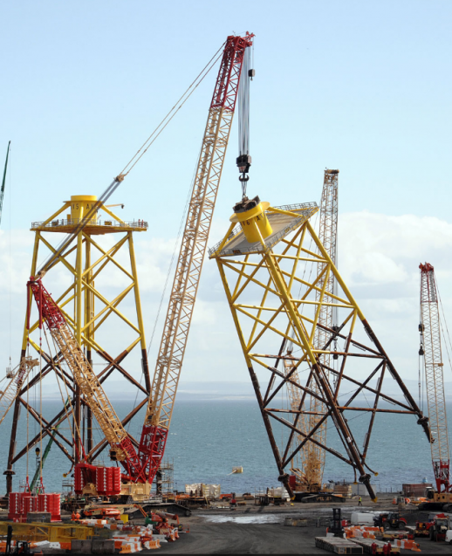
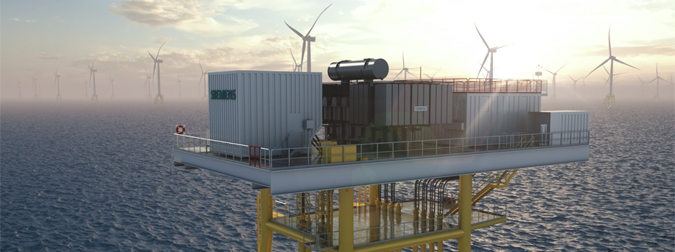
Technology improvements are real: Deployment on Beatrice
World’s deepest water jacket foundation
World’s first use of lightweight offshore transformer technology
photo simulation courtesy of Siemens

Slide 13
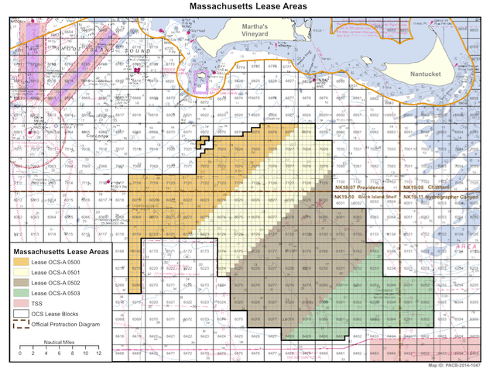
What do we know? Where to from here?
More offshore wind is coming
1600MW is just the start
Will be further from shore than first projects
Given complexity, “the market” might be the best planner
To the extent we do plan
Don’t force ‘solutions’ on generation developers unless the solutions are actually in place and available
Plans take time to develop, and visibility on implementation, in order to be useful

